Slide 1
TO-DO LIST
TEAM NO-16
SUBMITTED TO
-Mr. VIKAS PATEL
SUBMITTED BY-
Kartik Sharma 2210990489
Japish Bagga 2210990432
Jatin Gahlyan 2210990459
Arushi Chawla 2210990999

Slide 2
Table of Contents
Introduction
Problem Statement
Technical Details
Key Features
Project Highlights
Bonus Feature(optional)
Conclusion
References/Links used

Slide 3
Introduction
In this project, we will be creating a To-Do List using Html, Css and JavaScript. A to-do list is a tool used for organizing tasks and responsibilities. It typically consists of a list of items or tasks that need to be completed, along with deadlines or priorities assigned to each item.

Slide 4
Problem Statement
"In today's fast-paced world, individuals often struggle to manage their time effectively and prioritize tasks amidst competing responsibilities. Without a reliable system in place, important tasks can slip through the cracks, leading to missed deadlines and increased stress. As a result, there is a need for a convenient and customizable solution that empowers individuals to prioritize, and track their tasks efficiently, leading to improved productivity and reduced stress."

Slide 5
Technical Details
The project will use HTML, CSS, and Javascript. HTML will be used for layout and structure, while CSS will be used for styling and making the webpage visually appealing. Javascript will be used to implement the web functionality. Additionally, the project will leverage modern web development practices and frameworks to enhance efficiency and maintainability. Libraries such as Bootstrap or Tailwind CSS may be integrated to expedite the styling process and ensure responsiveness across various devices and screen sizes.
Furthermore, JavaScript frameworks like React.js or Vue.js could be utilized to build dynamic and interactive user interfaces, enabling seamless data manipulation and real-time updates without page reloads. These frameworks provide component-based architectures that streamline development and facilitate code reusability.
For backend functionalities and data management, the project might incorporate technologies such as Node.js for server-side scripting and handling asynchronous operations, along with.

Slide 6
HTML, CSS, JAVASCRIPT
HTML Structure: Start by creating the basic structure of your To-Do List using HTML. This will include elements such as:
An input field for users to add new tasks.
A button to submit new tasks.
An area to display the list of tasks.
CSS Styling: Apply CSS styles to make your To-Do List visually appealing and easy to use. You can customize the look of elements such as input fields, buttons, and list items to match your design preferences.
JavaScript Functionality: Implement the dynamic functionality of your To-Do List using JavaScript. This will involve:
Adding event listeners to handle user interactions, such as submitting new tasks.
Creating functions to add, remove, and update tasks in the list.
Storing tasks in a data structure, such as an array or object.
Updating the UI to reflect changes in the list of tasks.
Additional Features (Optional): Depending on your preferences and requirements, you can add additional features to enhance the functionality of your To-Do List. Some ideas include:
Adding due dates or priorities to tasks.
Implementing drag-and-drop functionality to reorder tasks.
Allowing users to mark tasks as completed.

Slide 7
Key Features
1. Task Creation:
Users will be able to easily add new tasks to the list.
2. Priority Levels:
Users should be able to assign priority levels to tasks to indicate their importance or urgency.
3. Due Dates and Reminders:
Users should be able to set due dates for tasks.
4. Task Status:
Tasks should have status indicators (e.g., "pending" or "completed") to track their progress.
5. Task Editing and Deletion:
Users should be able to edit task details or delete tasks when necessary.

Slide 8
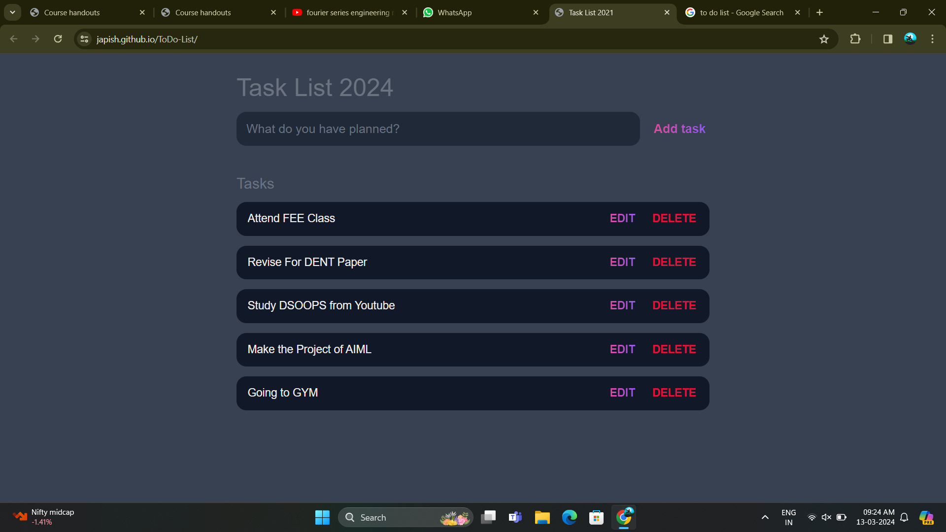
To Do List

Slide 9
Project Highlights
1. User-Friendly Interface
2. Scalability and Performance
3. Customizable Task Organization
4. Smart Task Prioritization
5. Integrated Calendar
6. Offline Access and Synchronization
7. Continuous Improvement and Updates

Slide 10
Conclusion
In conclusion, a to-do list is a fundamental tool for organizing tasks, managing time efficiently, and prioritizing responsibilities. Whether it's a simple handwritten list, a digital app, or specialized software, the purpose remains the same: to help individuals stay focused, track their progress, and ensure that important tasks are completed in a timely manner.

Slide 11
References/Links used
W3Schools - https://www.w3schools.com/
CSS-Tricks - https://css-tricks.com/
Codecademy -https://www.codecademy.com/

Slide 12


